Slide 1
FDI Analysis for various sectors

Slide 2
Tableau Worksheets

Slide 3
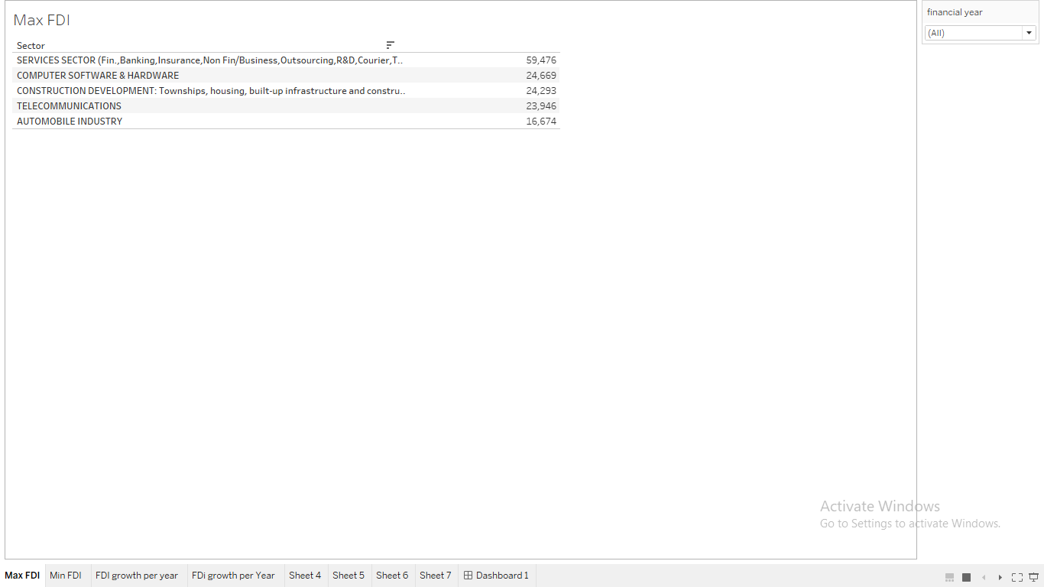

Slide 4
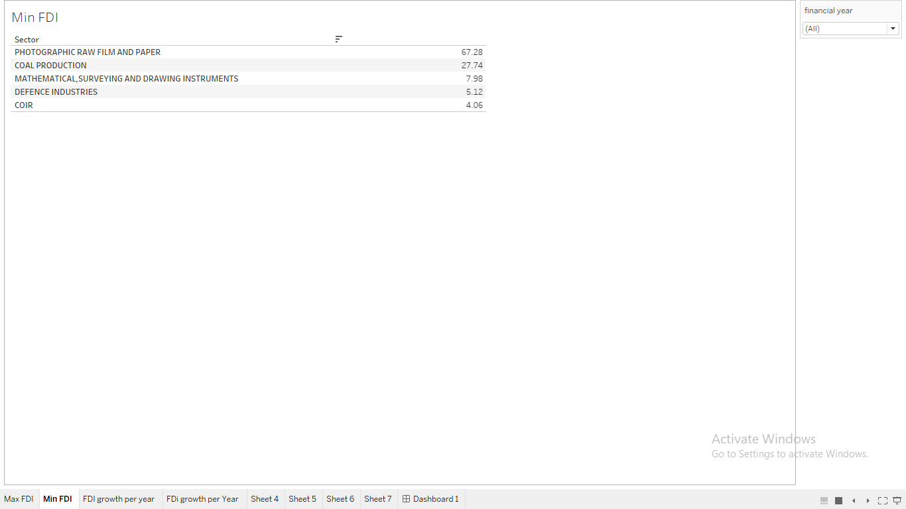

Slide 5
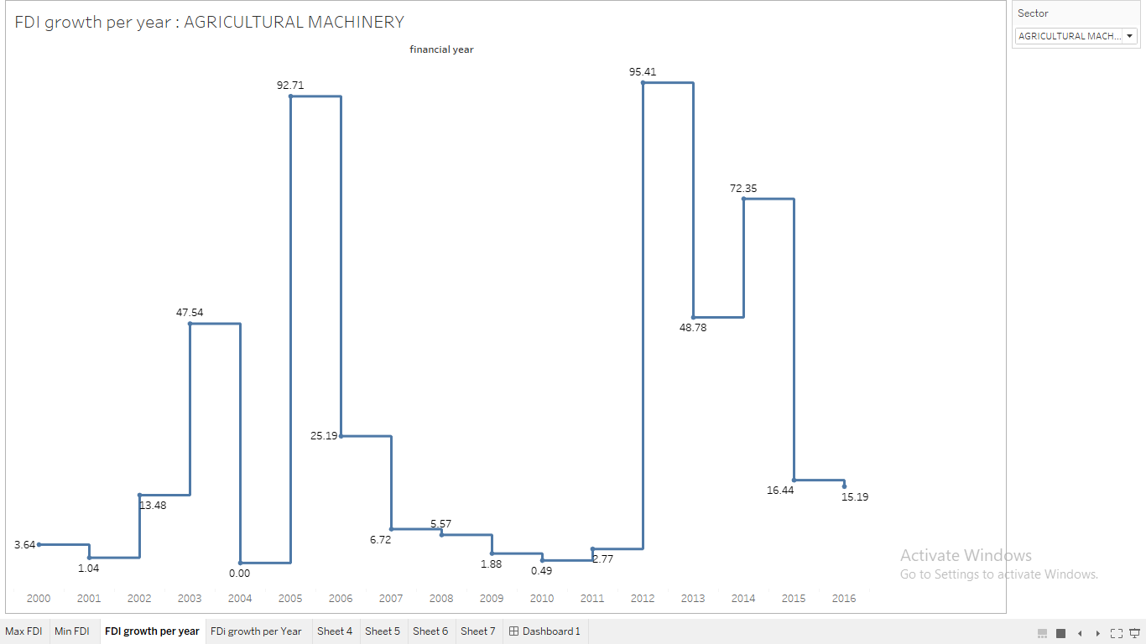

Slide 6
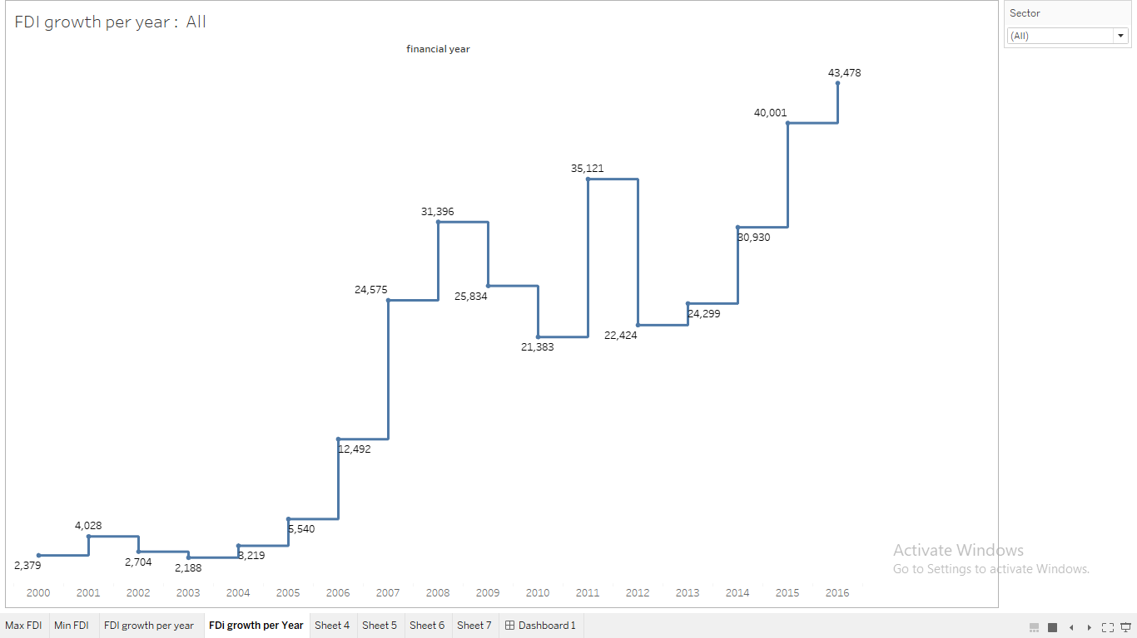

Slide 7
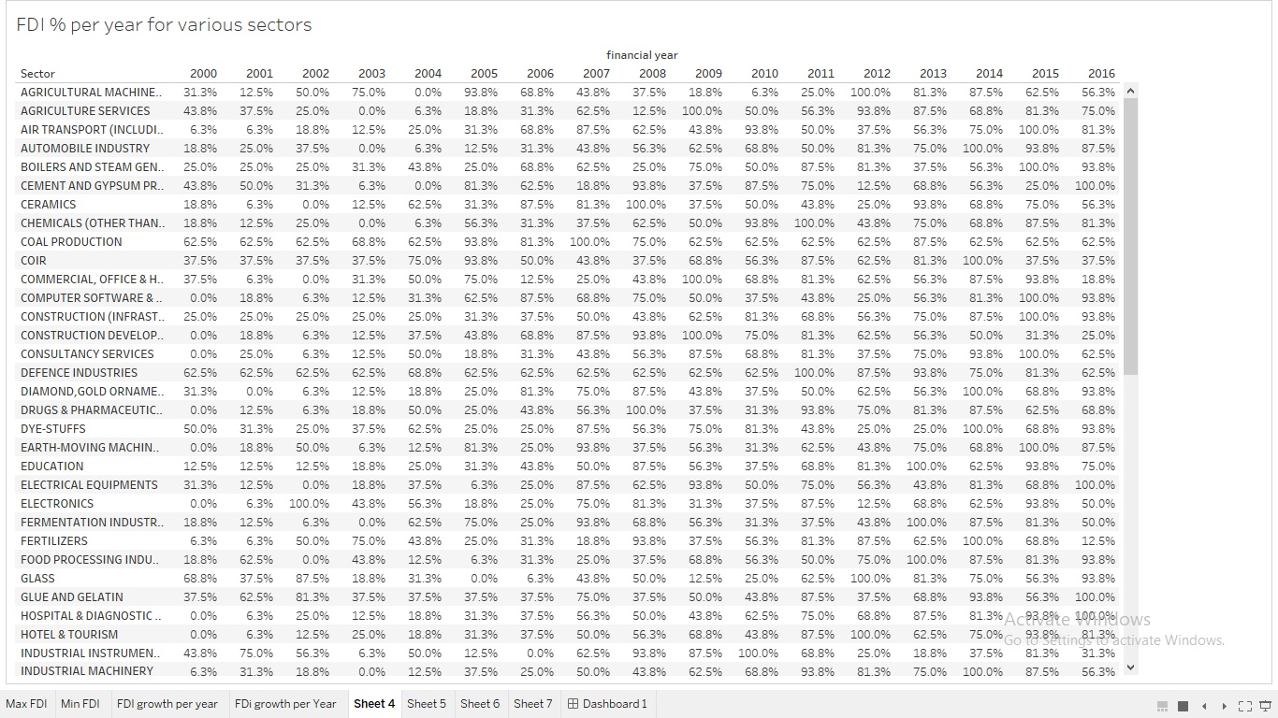

Slide 8
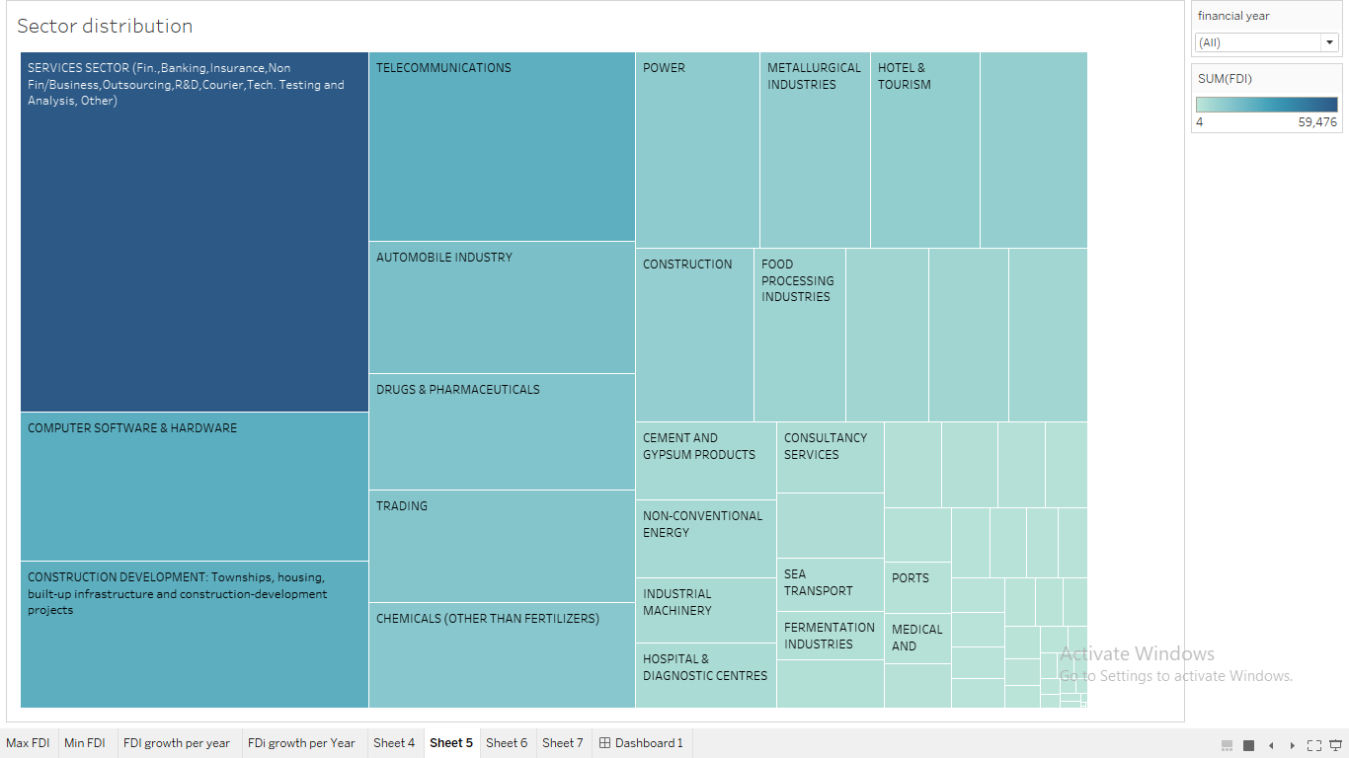

Slide 9
DASHBOARD
Click Here

Slide 10
